Slide 1
Notes:
This presentation was automatically generated by PowerPoint Copilot based on content found in this document:

Slide 2
Introduction to the TRE Vault Provider Portal

Slide 3
What We Will Cover Today

Slide 4
Topics
How to login to the Provider Portal
How to reset your password
Navigating your provider profile
Member Information
  General navigation
  Responding to Service Requests (referrals)
  Managing member documentation
Managing your agency’s active services
Next steps for any assistance you may need

Slide 5
How to Login to the Provider Portal

Slide 6
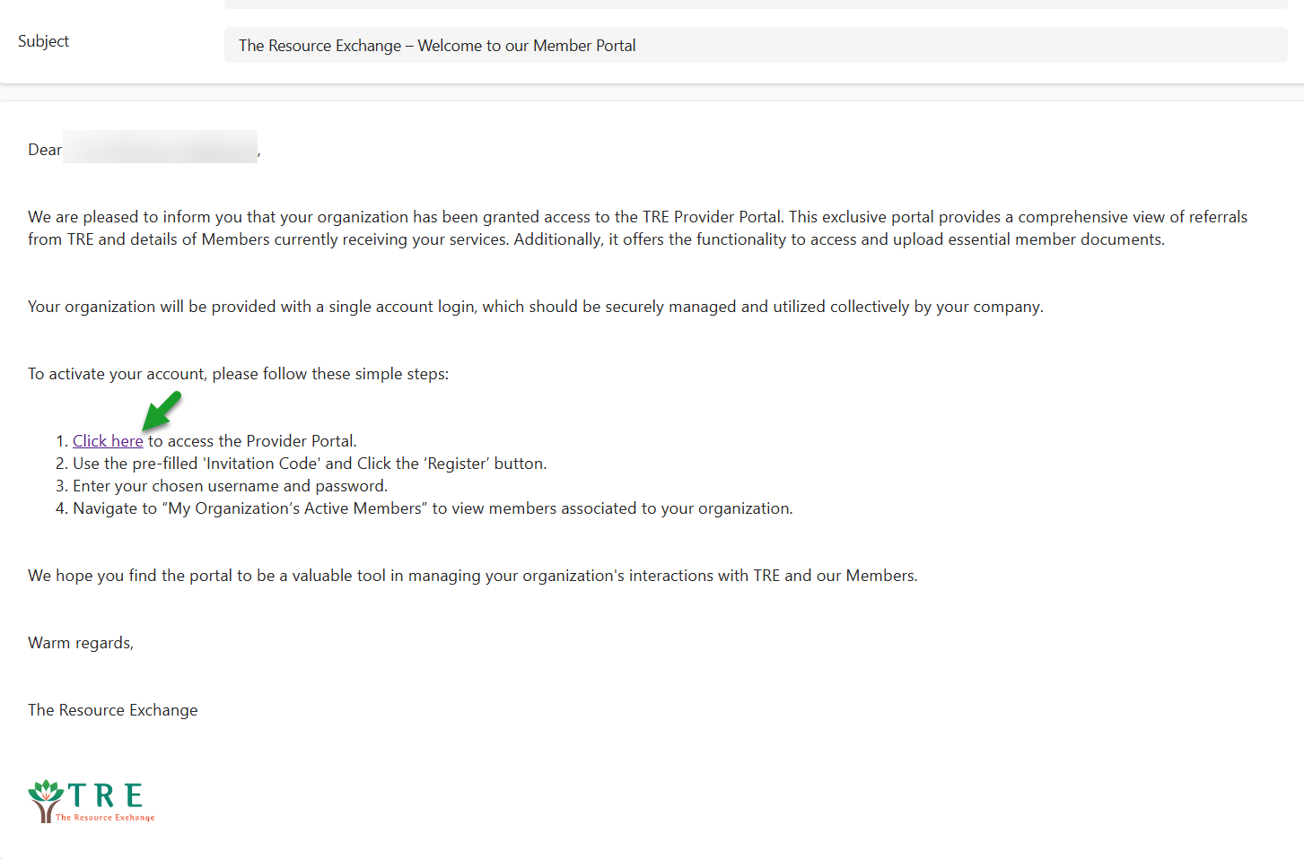
How to Login to Your Provider Portal
You will receive an invite from the Resource Exchange (TRE) to access the Provider Portal
In the invite, there will be a link “Click here”
    Click the link and you will be re-directed to the registration page

Slide 7
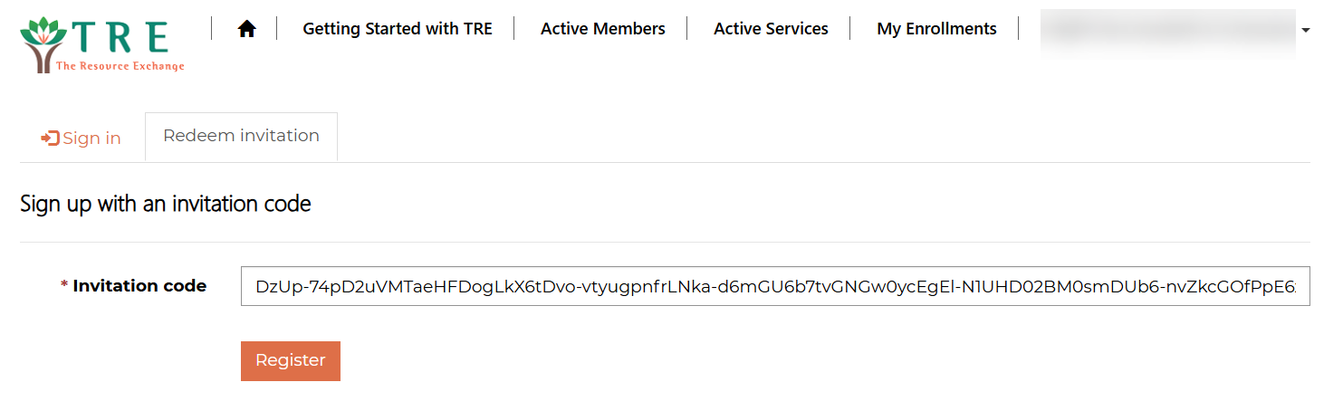
How to Login to Your Provider Portal Cont.
On this page, a unique code will auto-populate in the “Invitation Code” box
  Leave this code as-is
  Continue by clicking, “Register”

Slide 8
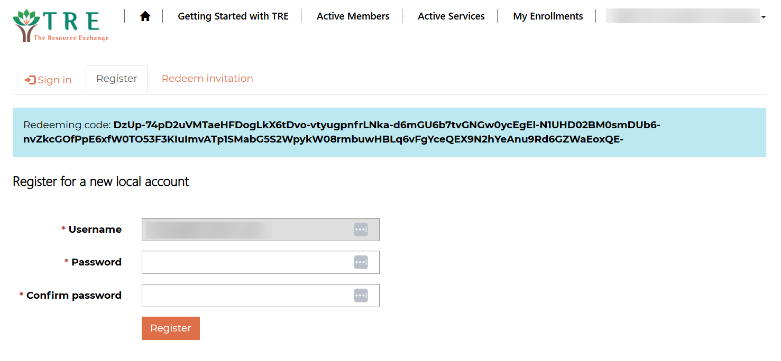
How to Login to Your Provider Portal Cont.
You will be brought to the next page where you will see your username and password
  Your username will default to the email address that received the invitation
  This cannot be changed/updated
    Any change would be made by contact Laura Thomas llthomas@tre.org
Enter your password and confirm it
Click “Register” to complete your registration

Slide 9
How to Reset Your Password

Slide 10
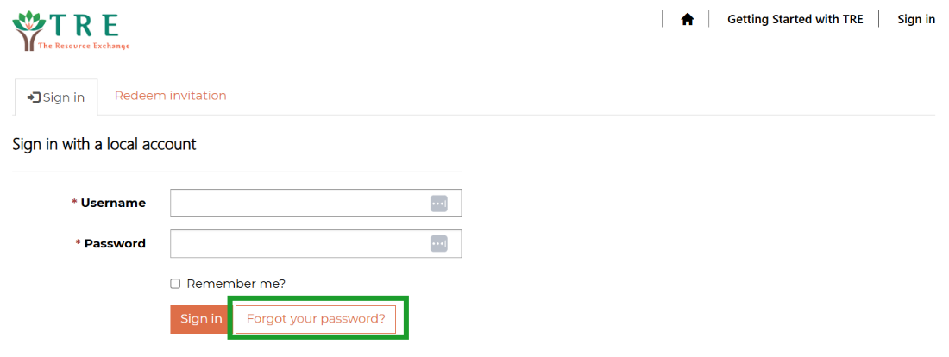
Forgot Your Password?
If you forget your password when signing in, click "Forget Password"

Slide 11
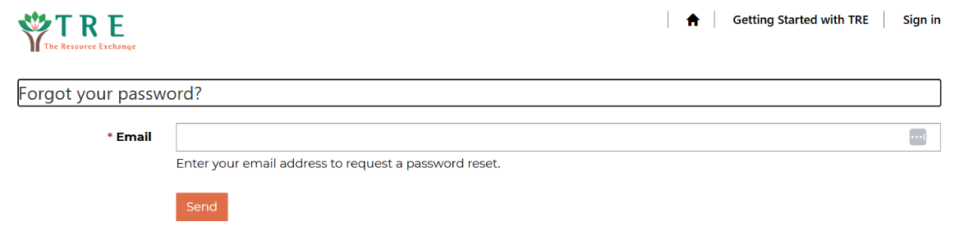
Forgot Your Password? Continued
You will be required to enter the email you registered with.

Slide 12
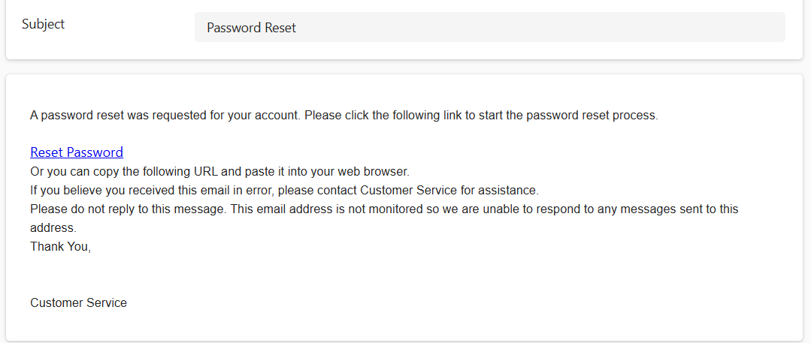
Forgot Your Password? Continued
After you click "Send", you will receive an email with instructions on to reset your password

Slide 13
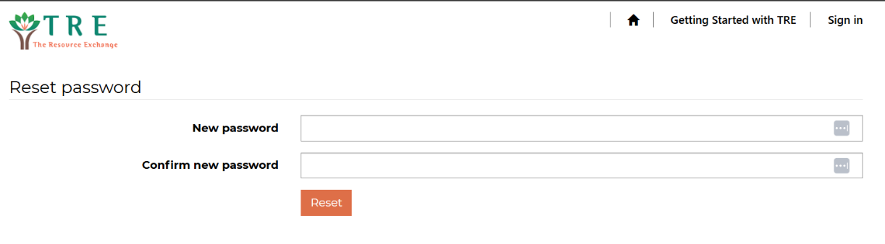
Forgot Your Password? Continued
Enter your new password and click "Reset"

Slide 14
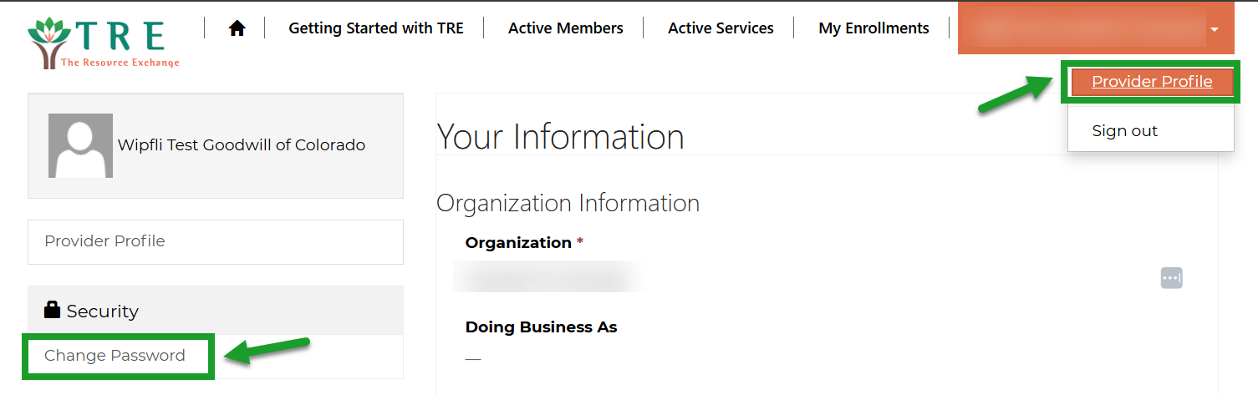
Forgot Your Password? Continued
If at any time you need to reset your password while you’re logged in, you can navigate to your Provider Profile to reset it

Slide 15

Locked Out
If you find that you are completely locked out of the Provider Portal please contact it@tre.org to assist you

Slide 16
Provider Profile

Slide 17

Navigating the Provider Profile
In the upper right-hand corner click the carrot down button next to the Provider name
Click "Provider Profile"

Slide 18
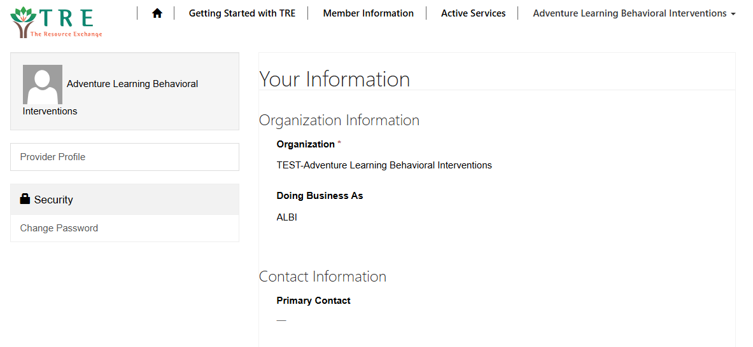
Navigating the Provider Profile
Here you will find your agency's information
You can edit Contact Information
Contact Laura Thomas llthomas@tre.org if you need to change any of the locked fields

Slide 19
Member Information

Slide 20
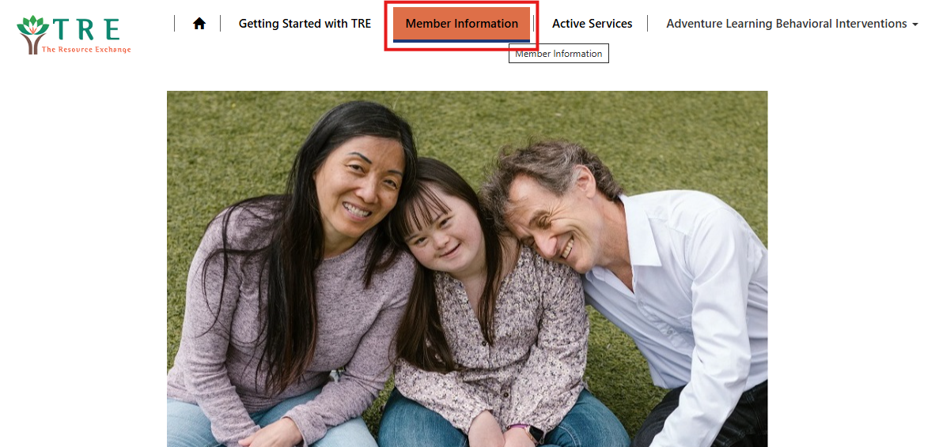
Member Information Tab
The Member Information Tab is located at the top toolbar of the Provider Portal

Slide 21
Member Information Tab
  Active Members
    These members have selected you as an agency to provide the specified service
    Even though a member may show in this section, you are not authorized to provide services prior to receiving an active PAR
  Member Referrals
    These are members who have sent a Service Request to your agency in the last 5 business days that you have not yet responded to
  Interested in Providing Services
    A list of members that you have reviewed the Service Request information and have responded that you are interested in moving forward with the process
  Not Selected to Provide Services
    A list of members that have selected a different agency as the result of the Service Request Process
  Expired Requests
    Service Requests that have exceeded the 5 business days to respond and are no longer available
    These will fall off this list after 30 days

Slide 22
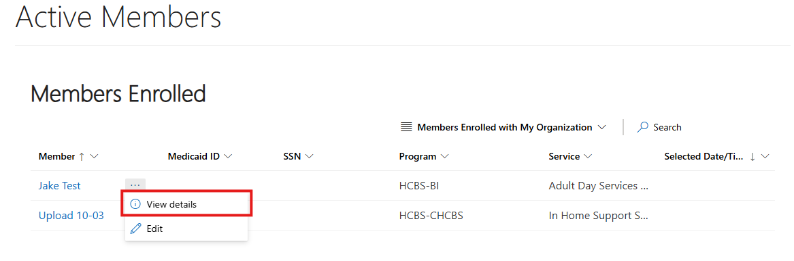
Active Members
To view the details of the member, click the three dots to the right of their name, then "view details“ or single-clicking the member’s name

Slide 23
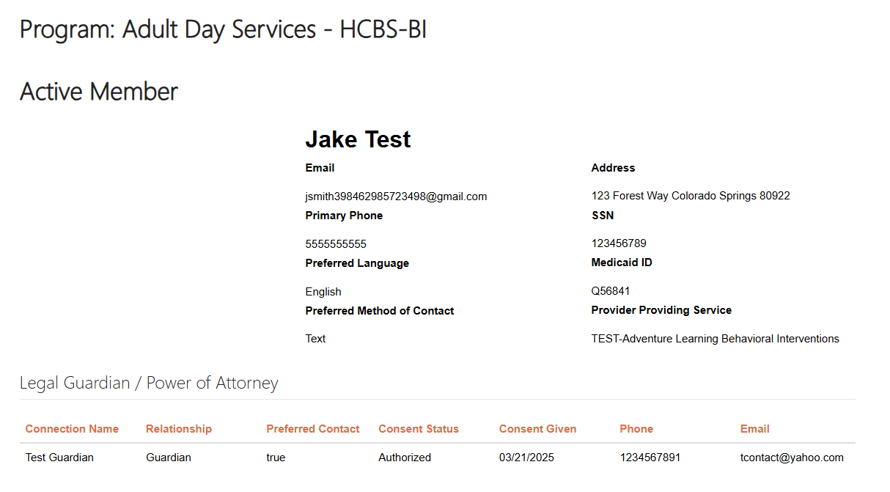
Active Members Continued
This page will show you the details on that active member
This page includes demographic information, Guardian/POA, associated TRE documents, and the contact information of TRE staff supporting this individual
You are also able to contact TRE staff through this page

Slide 24
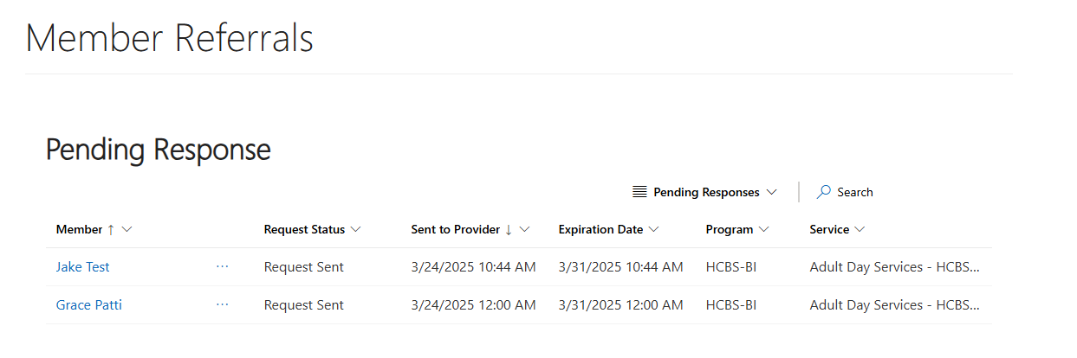
Pending Response
These are members who have sent a Service Request to your agency in the last 5 business days that you have not yet responded to

Slide 25
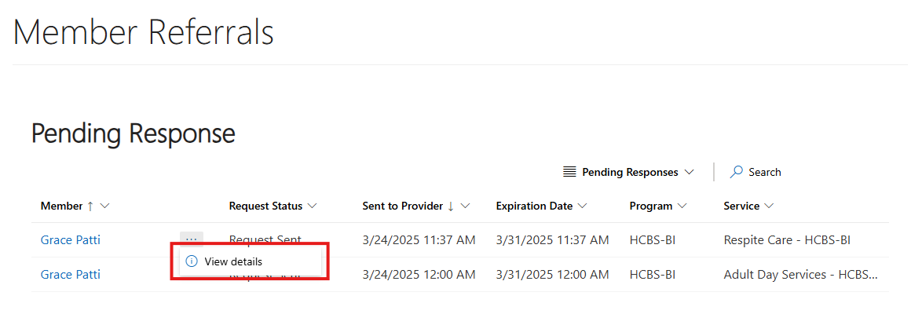
Pending Response Continued
To view the details of the Service Request, click the three dots next to their name then "view details"

Slide 26
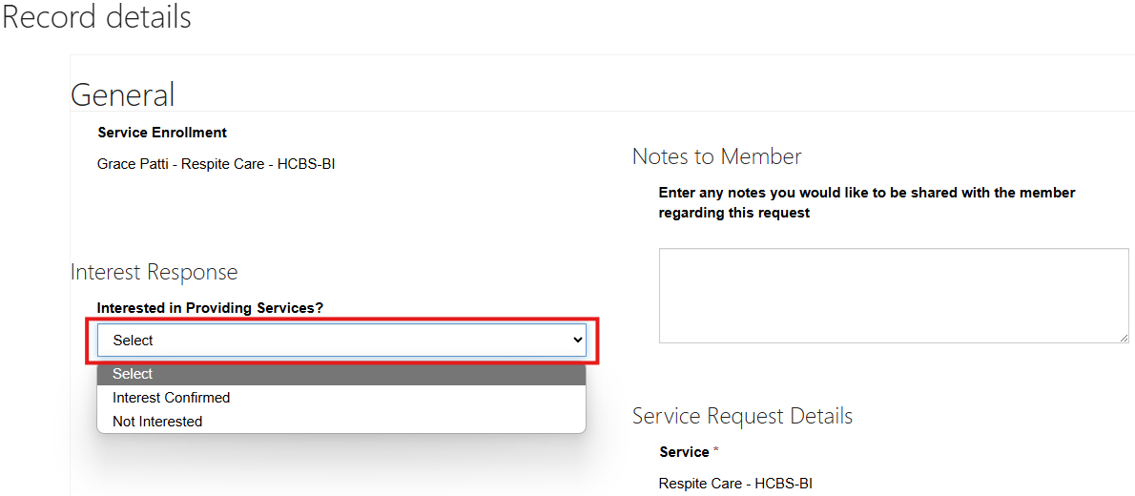
Pending Response Continued
Respond directly to Service Requests on this page
Click the drop down to select if you are interested in providing Services or not
Click submit after the Service Request has been reviewed and you have made the decision of if you would like to move forward with the process

Slide 27
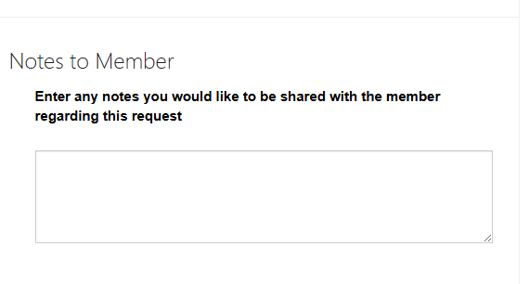
Pending Response Continued
Here is where you can provide any additional information to the member, such as a note about why someone should select your agency
Please include the best email and/or phone number for the member to respond to
This information will be shared with the member by the Service Coordinator after the 5 days for the request have concluded

Slide 28
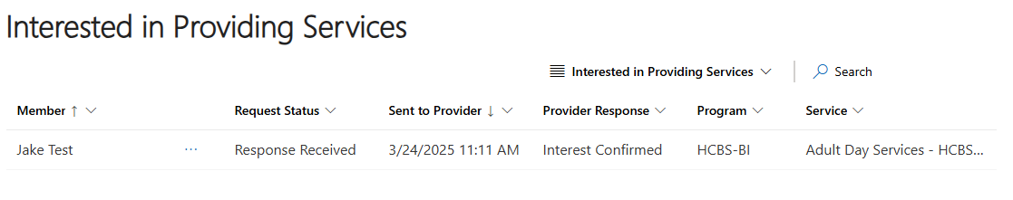
Interested in Providing Services
Here is the list of members you have identified and responded to stating that you are interested in moving forward with the Service Request process

Slide 29
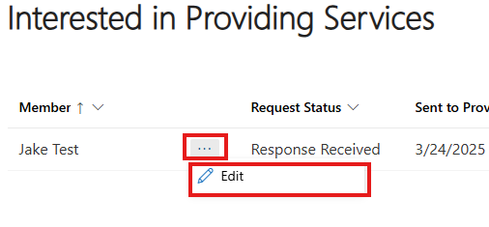
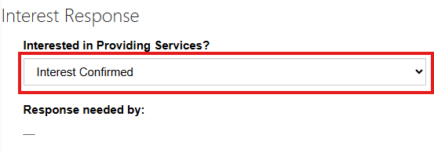
Interested in Providing Services Continued
To edit your response in providing services, click the three dots next to their name, then edit
  You can edit whether or not you are still interested in providing services here

Slide 30
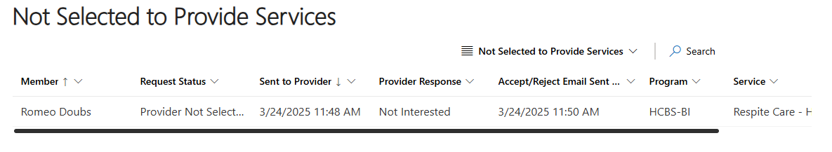
Not Selected to Provide Services
Here you can find a list of the members that did not select you as a provider.

Slide 31
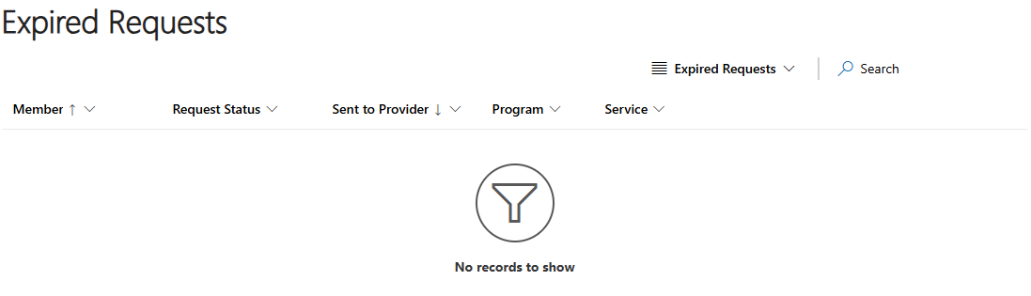
Expired Requests
Service Request that have exceeded the five business days to respond and you are no longer able to respond. These will fall off after 30 days.

Slide 32
Managing Member Documents

Slide 33
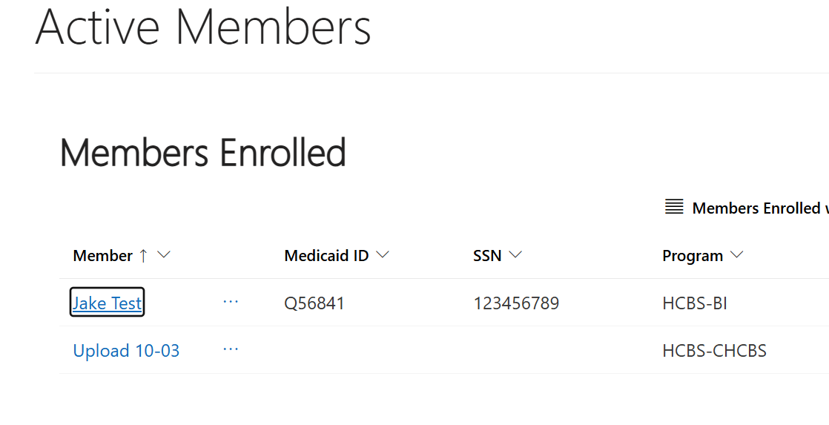
How to Manage Member Documentation
To access member documents, you can single-click on their name in the “Members Enrolled” section under the “Member Information” tab on the top toolbar
A member will be noted here once they have selected your agency
  This DOES NOT necessarily mean they have an approved PAR

Slide 34
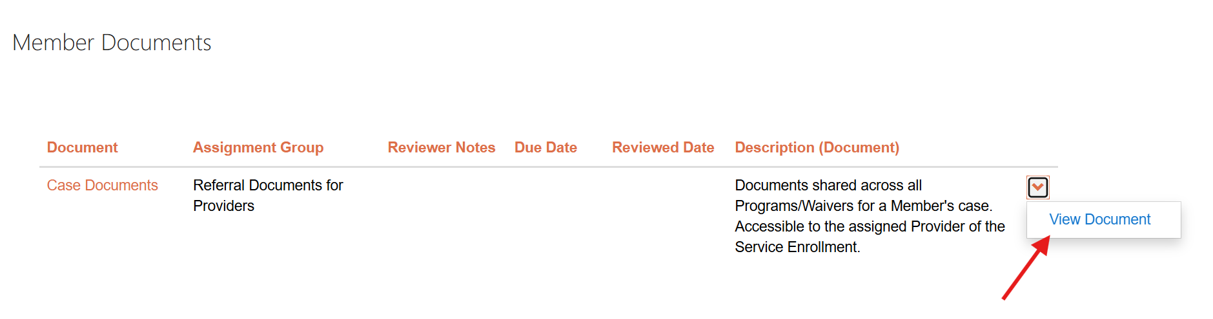
Downloading Member Documents From TRE
To view any documents that TRE has connected to that member’s profile you will go to the “Member Documents” section and click the caret next to any document you would like to view and click “View Document”
It is your agency’s responsibility to pull any documents from this area and save them as needed as this will be the way that TRE is sharing this documentation
Once a member is disconnected from your agency in the Vault, you will no longer have access to download this documentation

Slide 35
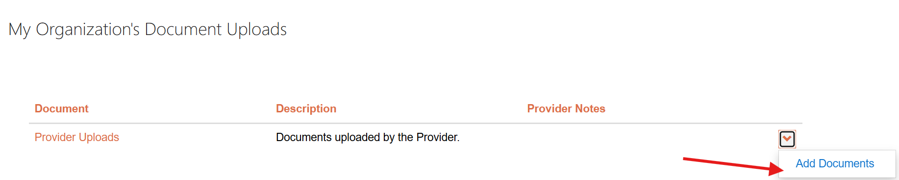
How to Upload Documents to Share with TRE
To upload any documents that you would like to share with TRE, go to the “My Organization’s Document Uploads” section and click the caret at the end of the row and select “Add Documents”

Slide 36
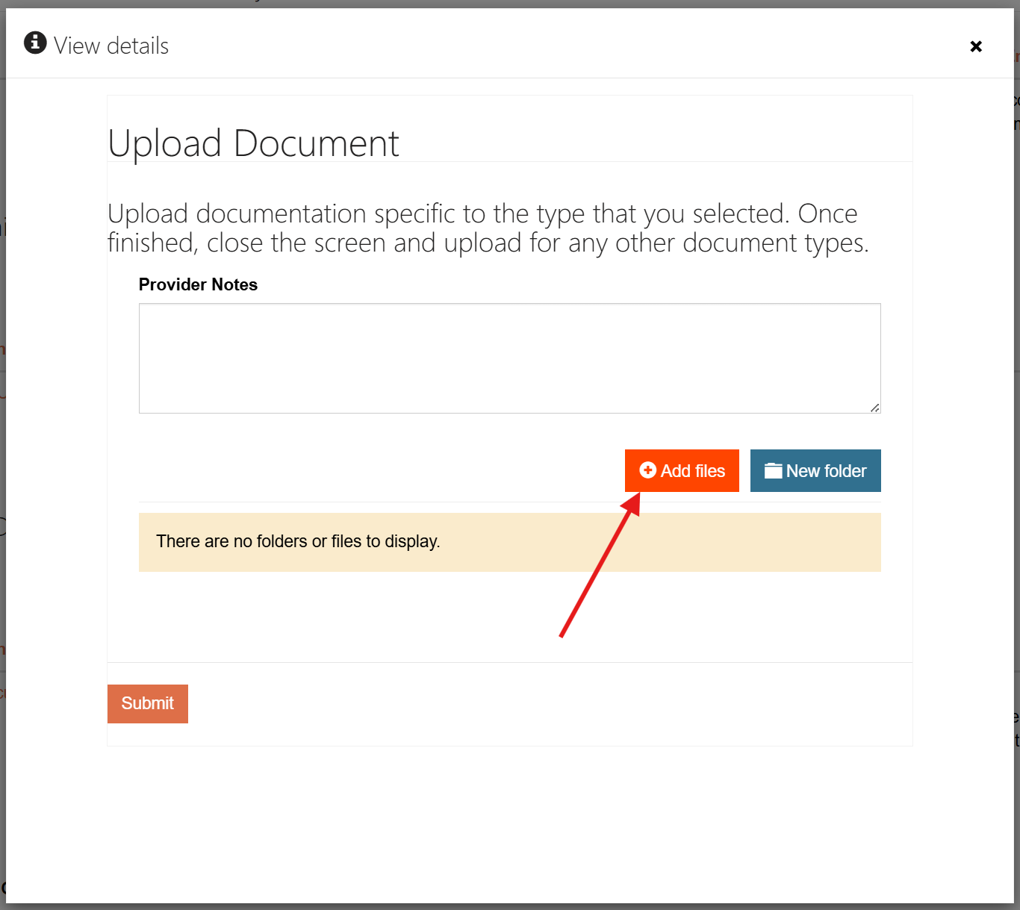
How to Upload Documents to Share with TRE Cont.
A pop-up window will appear to upload the document, please enter any necessary notes and select “Add Files”

Slide 37
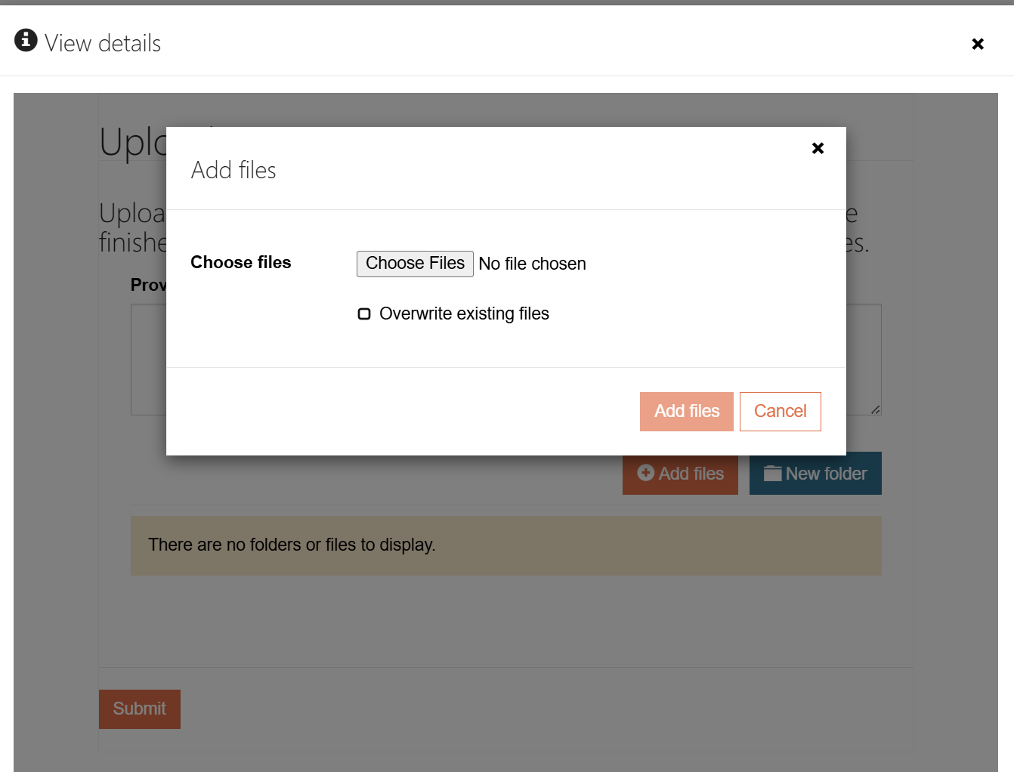
How to Upload Documents to Share with TRE Cont.
You can then upload any documents from your device by selecting the “Choose Files” option
Upload any documents using the naming format of “Document Name, mm.dd.yyyy, Member Last Name, Member First Name”
Click “Add files” to attach the documents
Finish the process by clicking “Submit”

Slide 38
Examples of Documents that You May Upload
Behavior Assessments and Behavior Plans
Plans of Care
IHSS Shared Responsibility Form
Informed consents
Rights Modification Forms
PMIP
Protocols
Residential or Day skills assessment
Health and Safety Assessments
Medical forms
Court orders

Slide 39
Navigating Member Lists

Slide 40
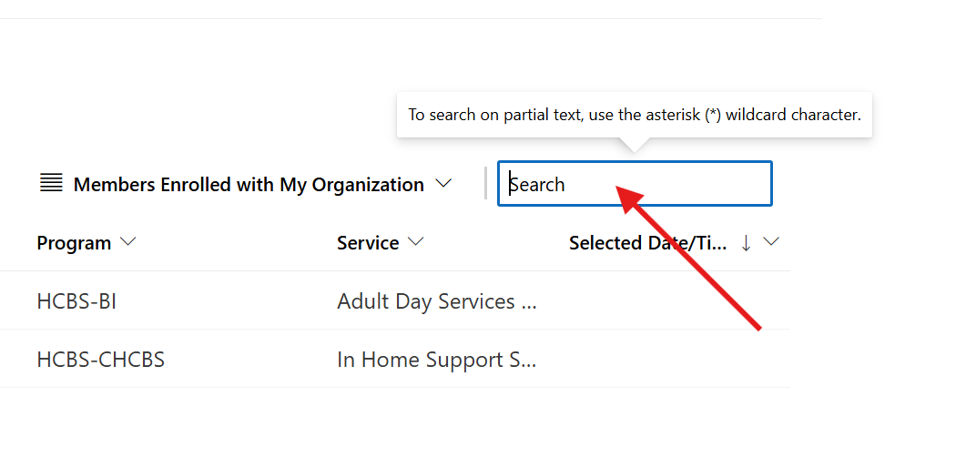
Options to Navigate a List of Members
Searching
When searching any list of members you can find them by clicking in the search bar at the top right of the list
If you would like to search partial text you can use an asterisk (*) before entering into the field

Slide 41
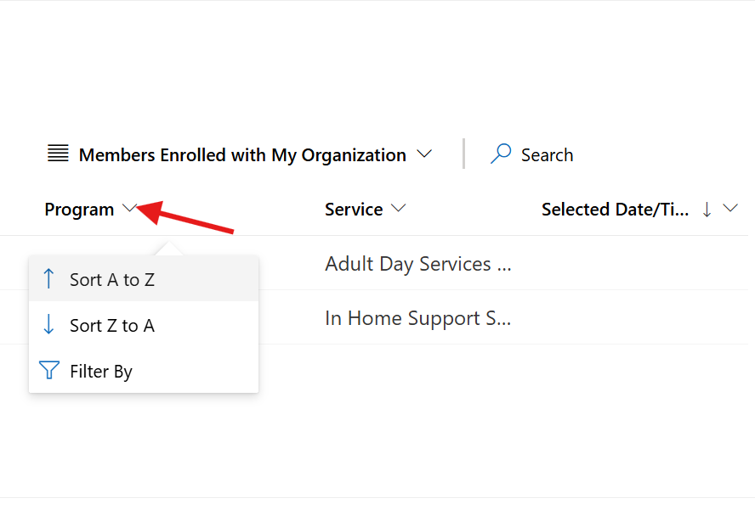
Options to Navigate a List of Members
You can also sort and filter any column within the list by clicking the caret next to the column title
Sorting allows you to organize the data alphabetically or numerically in descending or ascending order

Slide 42
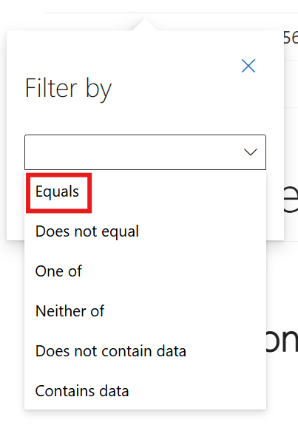
Filter By
You can also filter any column by selecting “filter by”
This allows you to filter by a variety of parameters as you see in the screenshot
If you know the title of the data you are looking for, select “equals” and type in the data value to bring up that entry

Slide 43
Managing Your Agency’s Active Services

Slide 44
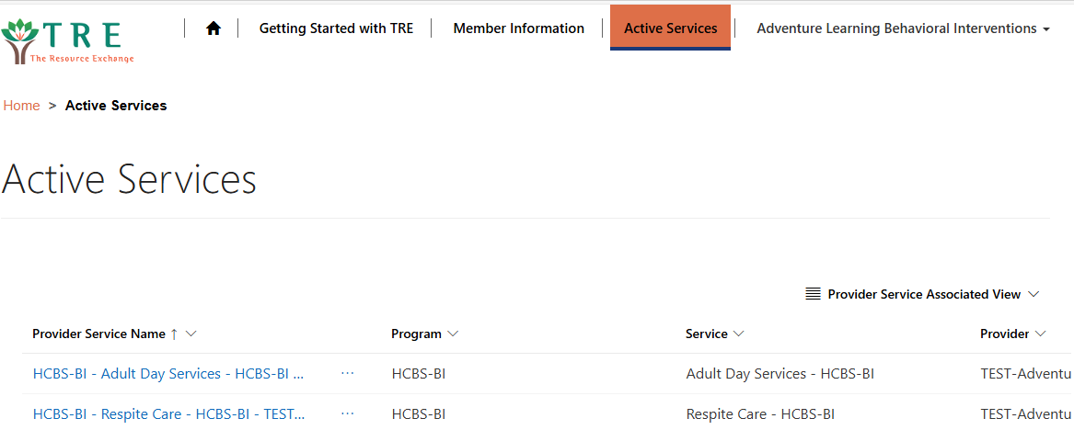
Active Services
You can view what services you are approved to provide by clicking the “Active Services” tab in the top toolbar
If there are any services that do not appear to be accurate, please contact Laura Thomas llthomas@tre.org to address any concerns

Slide 45
Additional Assistance

Slide 46
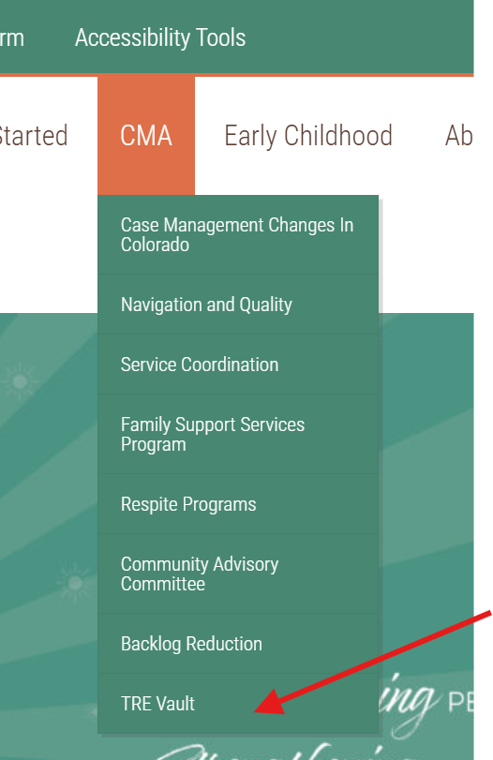
How Do I Get More Information or Assistance?
Vault Ventures Office Hours
  Contact IT for the next scheduled session
Access the tools on the www.tre.org
  Navigate to the CMA Toolbar
  Select “TRE Vault”
Contact your assigned Service Coordinator

Slide 47
Questions?

